Slide 1
Software Requirement Specification
Project on : Hotel Management System
Prepared by,
Abul Hossain
Id : 1246643
Round- 39

Slide 2
Hotel Management system

Slide 3
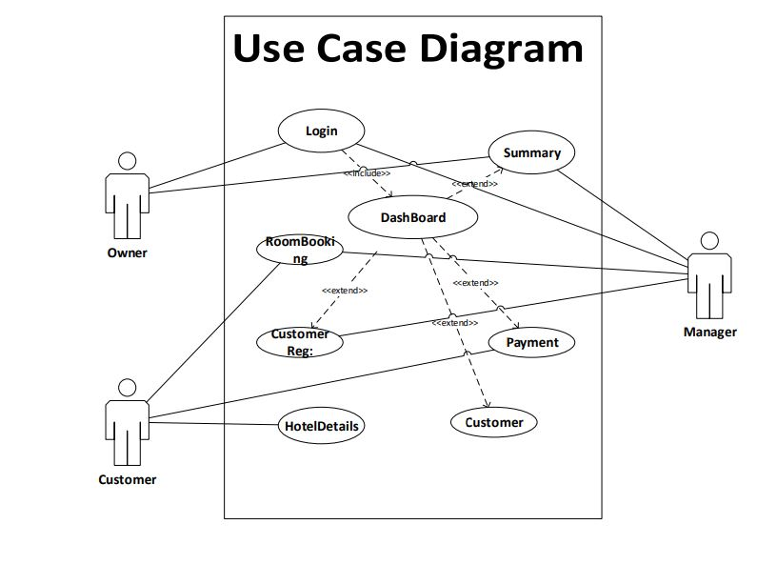
Use Case

Slide 4
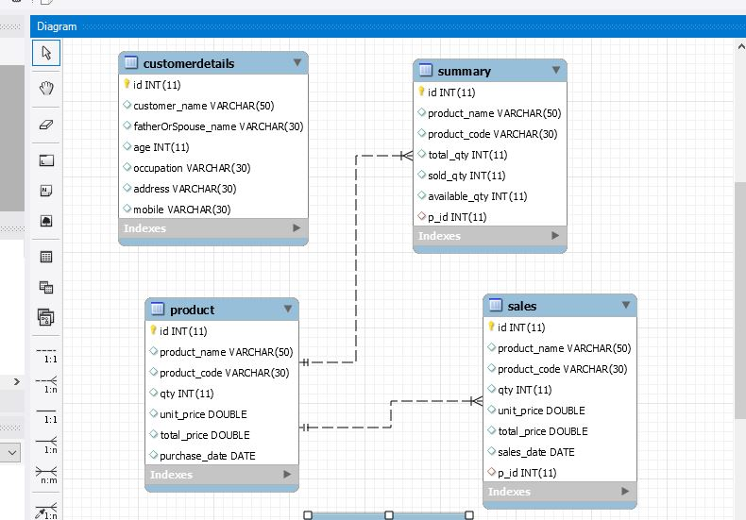
Class Diagram

Slide 5
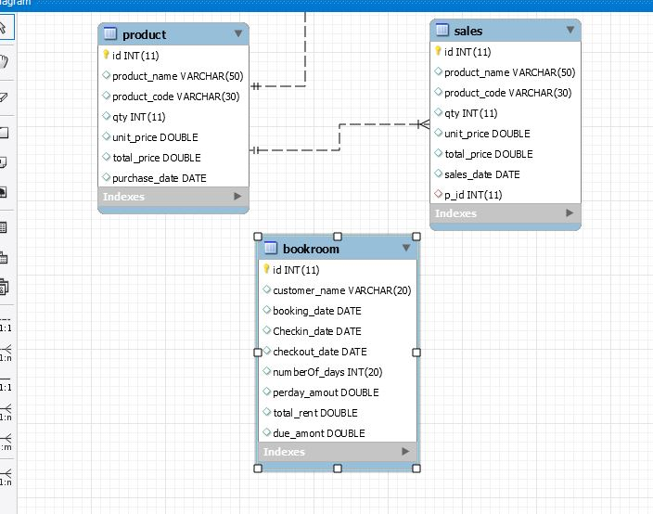
Class Diagram

Slide 6
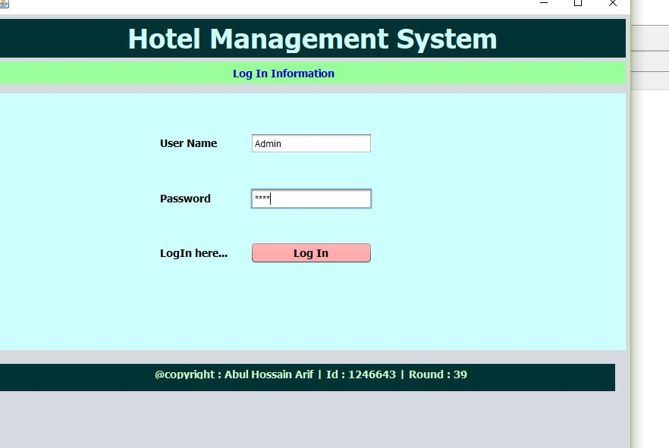
Log in Page

Slide 7
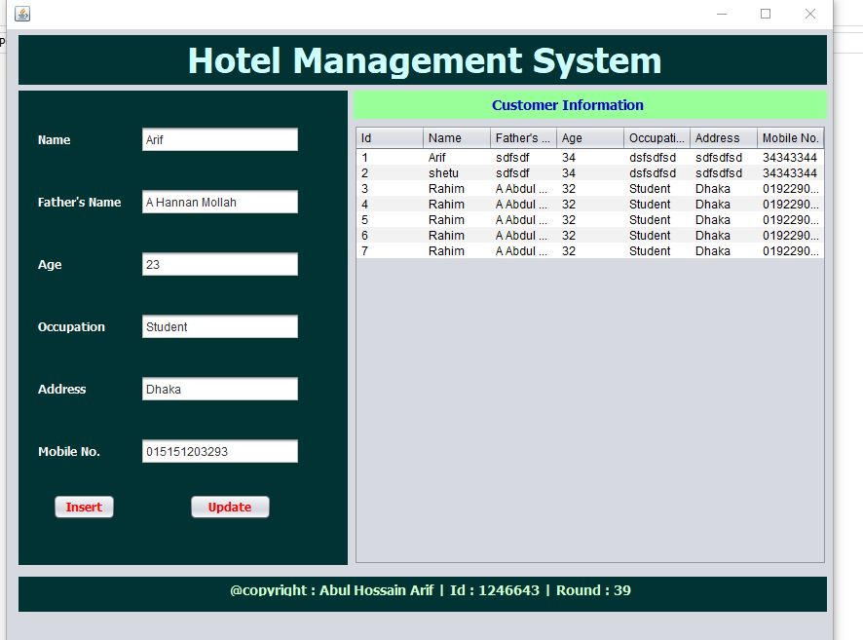
Customer Information

Slide 8
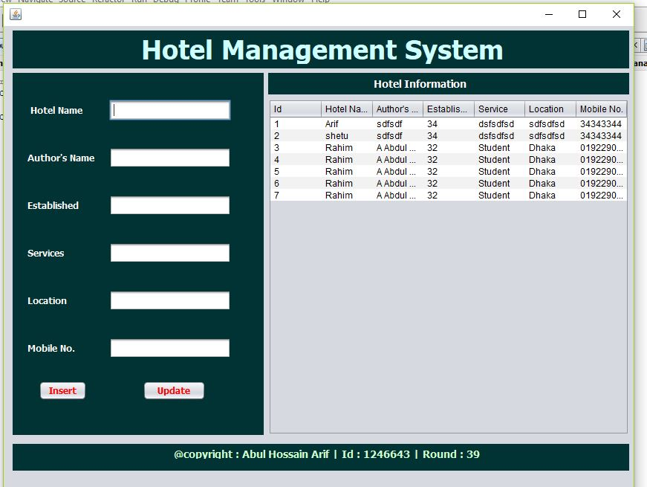

Slide 9
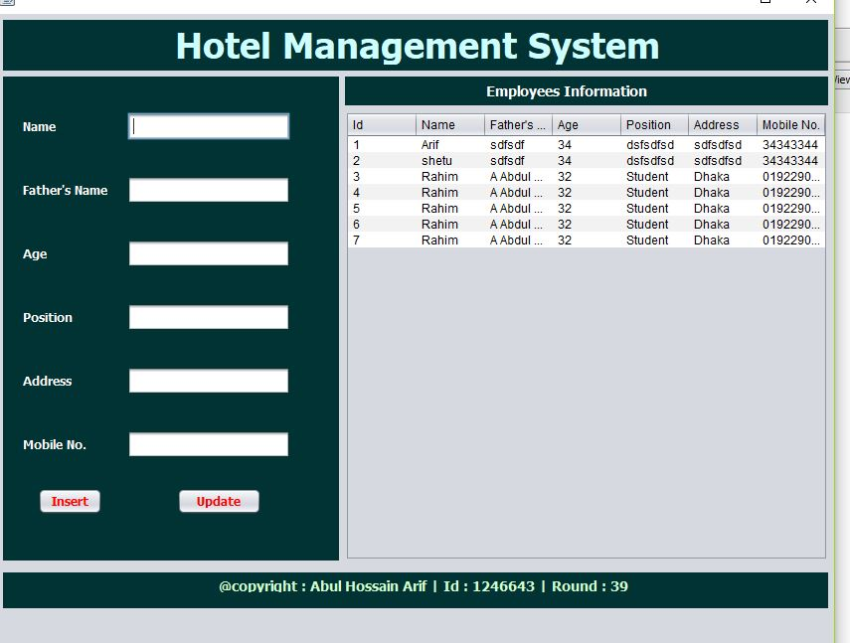
Employees Information

Slide 10
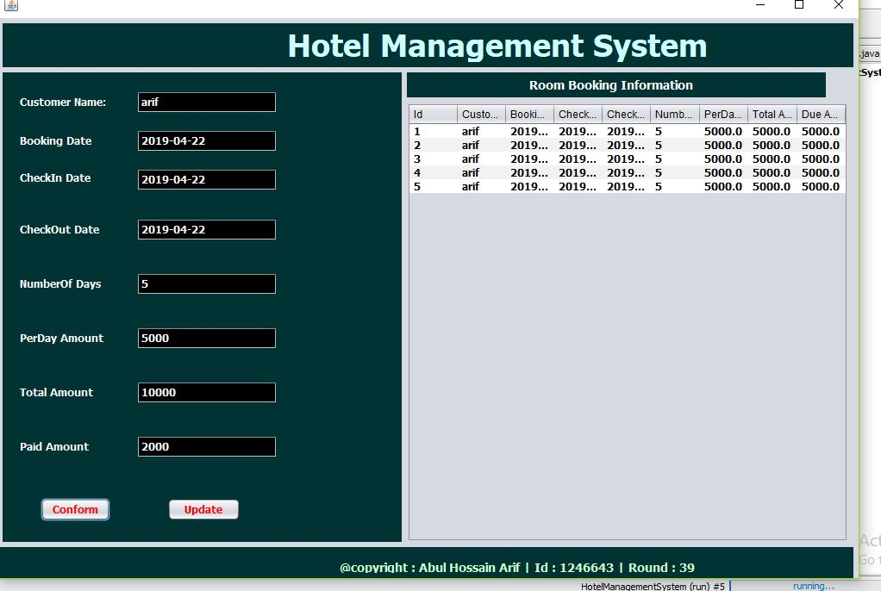
Room Booking Information

Slide 11
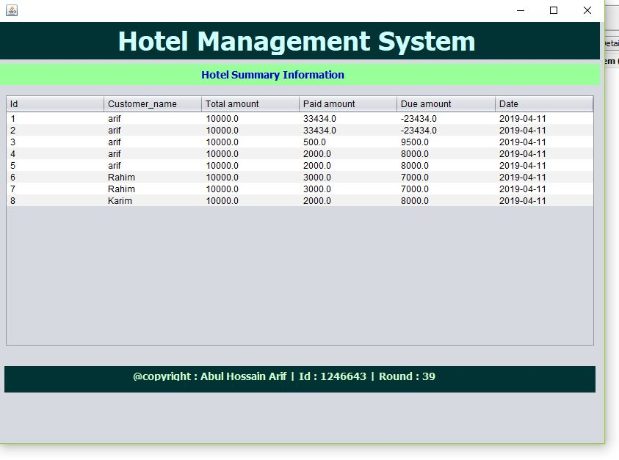
Summary Information

Slide 12
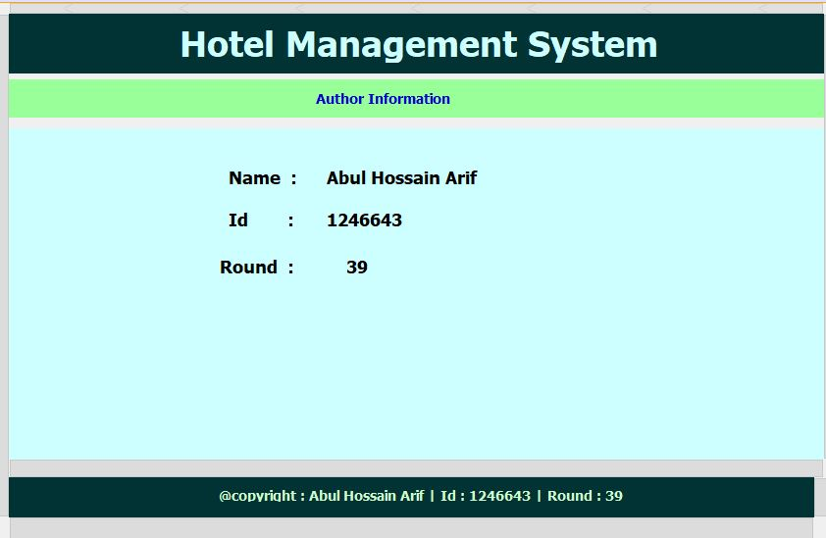
Author Information

Slide 13
Thank You Sir

